Slide 1
An Overview of Cryptography (Part II)

Slide 2
Message Authentication
Protection against falsification of data and transactions.
Message authentication is a procedure that allows communicating parties to verify that the received messages are authentic.
  Contents of the message have not been altered.
  Source is authentic.
  Message’s timeliness.
    Avoid replay attack
  Sequence relative to other messages flowing between two parties.

Slide 3
Using conventional encryption
  Encrypt the whole message
  Assume that only the sender and the receiver share a key
  Only the genuine sender would be able to encrypt a message successfully
  Include error-detection code and sequence number.
    Assured that no alternations have been made
    Sequencing is proper
  Include timestamp
    Assured that the message has not been delayed
    Avoid replay attack

Slide 4
Without message encryption
  An authentication tag is generated and appended to each message.
  The message itself is not encrypted and can be read at the destination independent of the authentication function.
  Advantage:
    Save execution time
      For example, one side has a heavy load and cannot afford the time to decrypt all incoming message.
  Disadvantage:
    Message confidentiality is not provided.
      May not be a problem for broadcast messages

Slide 5
Message Authentication Code (MAC)
  Involves the use of a secret key to generate a small block of data.
    Known as Message Authentication Code (MAC)
  Both parties (A and B) share a common secret key K_{AB}
  When A sends a message M to B
    It calculates the message authentication code
    MAC_{M} = F(K_{AB}, M)
    The recipient performs the same calculation on the received message.
    The received code is compared to the calculated code.

Slide 6
Message Authentication using a Message Authentication Code (MAC)
Message
K_{AB}
transmit
MAC
Algorithm
Compare
MAC
Algorithm
MAC
K_{AB}

Slide 7
One-way Hash Function
  A one-way hash function H accepts a variable-size message M as input and produces a fixed-size message digest h as output.
    One-way hash function H(M) = h:
      Given M, it is computationally easy to generate h
      Given h, it is computationally infeasible to find M
  Unlike the MAC function, the one-way hash function H does not take a secret key as input.
  To authenticate a message, the message digest is sent with the message in such a way that the message digest is authentic.

Slide 8
(a) Using conventional encryption
Message
transmit
H
K_{AB}
Compare
D
H
K_{AB}
Authentication: Yes
Nonrepudiation: No
E
Notes:
Nonrepudiation: after the sender sending a message, the sender cannot deny that he/she did not send the message
Problem: Receiver can pretend to be the sender as it also knows K_{AB}.

Slide 9
(b) Using public-key encryption
Message
transmit
H
K_{public}
Compare
D
H
K_{private}
Authentication: Yes
Nonrepudiation: Yes
E
Notes:
Encryption: sender's private key
Decryption: sender's public key
The receiver does not have the sender's private key → ensure nonrepudiation

Slide 10
(c) Using secret value (shared by the sender and the receiver)
Secret
value
Secret
value
Message
transmit
H
Compare
H
Authentication: Yes
Nonrepudiation: No
The advantage is that no encryption algorithm is required.

Slide 11
Secure Hash Functions
One-way hash function
Important for
  Message authentication
  Digital signatures
Produce a “fingerprint” for a file, message, or block of data.

Slide 12
Requirements (for hash function H)
  H can be applied to a block of data of any size.
  H produces a fixed-length output.
  H(x) is relatively easy to compute for any given x, making both hardware and software implementations practical.
  Suppose H(x) = h. For any given code h, it is computationally infeasible to find x.
    Preimage resistance (one-way)
  Suppose H(x) = H(y) where x ≠ y. For any given block x, it is computationally infeasible to find y.
    Second preimage resistance / Weak collision resistance
  It is computationally infeasible to find any pair (x, y) such that H(x) = H(y).
    Strong collision resistance

Slide 13
  The first three properties are requirements for practical applications.
  The 4th property is the “one-way” property.
    Otherwise, for method (c), the secret value can be deduced
  The 5th property prevents an encrypted hash code can be used with another message.
    Otherwise, for method (a) and (b), the hacker can append the same signature to another message and pretend to be the sender.
  A hash function having the 6th property is a strong hash function
    Otherwise, it is a weak hash function.
  The 6th property is used to protect against the birthday attack.

Slide 14
Birthday paradox
  It gets its name from the surprising result that the probability that two or more people in a group of 23 share the same birthday is greater than 0.5.
  If a function, when supplied with a random input, returns one of k equally-likely values, then by repeatedly evaluating the function for different inputs, the chance to have the same output is 50% after about 1.2k^{0.5} samples.
  For the above birthday paradox, replace k with 365.
Notes:
For simplicity, we exclude leap year and assume that the 365 possible birthdays are equally-likely.
100% for 366 people
99.9% for 70 people
~50% for 23 people

Slide 15
Details of the attack
  Suppose to sign a message, one has to append a m-bit signature.
  The opponent who tries to trick a victim to sign a fraudulent message:
    Generates a set of 2^{m/2} normal messages, all conveying the same meaning.
    Generates another set of 2^{m/2} fraudulent messages, all conveying the same meaning.
    Matches the two sets to find a pair of messages (one normal and one fraudulent) with equal hashing code.
      By birthday paradox, the probability of success is high.
    Offers the victim the paired normal message to sign.
    Attaches signature with the paired fraudulent message and claims that the victim has signed the paired fraudulent message

Slide 16
MD5 Message Digest Algorithm
  Developed by Ron Rivest in 1992.
  Input: arbitrary length.
  Output: 128-bit message digest.
  The difficulty of coming up with two messages having the same message digest (i.e., collision) is on the order of 2⁶⁴ operations.
  Finding a message with a given digest is on the order of 2¹²⁸ operations.

Slide 17
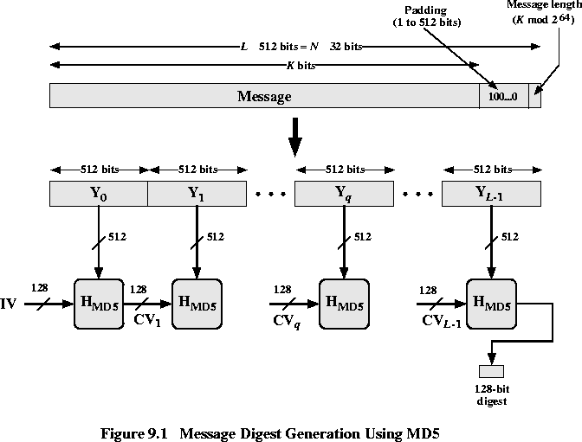
Source:http://cwx.prenhall.com/bookbind/pubbooks/stallings8/chapter0/deluxe.html

Slide 18
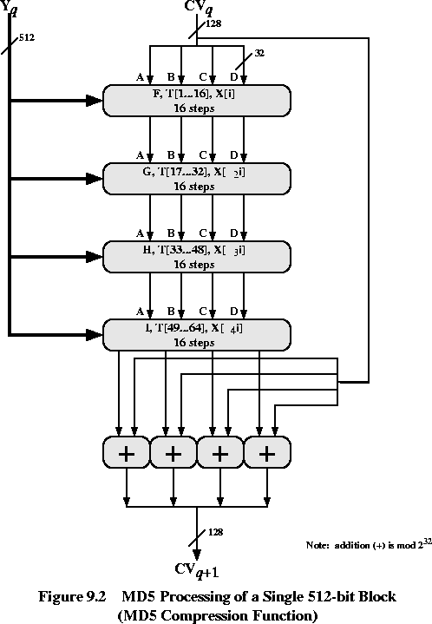
Source:http://cwx.prenhall.com/bookbind/pubbooks/stallings8/chapter0/deluxe.html

Slide 19
  However, MD5 is now considered broken and should not be used
    A practical collision attack with the complexity of 2¹⁸ operations is presented in 2013
      Can be done by modern computers in a few seconds
    A theoretical preimage attack with the complexity of 2^{123.4} operations is presented in 2009
Notes:
MD5 Collision
http://www.mscs.dal.ca/~selinger/md5collision/
Xie Tao, Fanbao Liu, and Dengguo Feng, Fast Collision Attack on MD5, EUROCRYPT 2013
Yu Sasaki and Kazumaro Aoki, Finding Preimages in Full MD5 Faster than Exhaustive Search, EUROCRYPT 2009

Slide 20
Other Secure Hash Function
  As was the case with symmetric block ciphers, designers of secure hash functions have been reluctant to depart from a proven structure.
    DES : Feistel cipher
      Many subsequent block ciphers follow the Feistel design.
  Similarly, most important modern hash functions follow the basic structure of
  Merkle–Damgård (MD) construction.
  The structure can produce a secure hash function.
  Concentrate to design a collision-resistant compression function.

Slide 21
SHA-1 Secure Hash Function
  The Secure Hash Algorithm (SHA) was developed by the National Institute of Standard and Technology (NIST).
  Published as a Federal Information Processing Standard (FIPS PUB 180) in 1993.
  The revised version was issued in 1995 and is generally referred to as SHA-1.
  Input message with max length of 2⁶⁴ - 1bits.
  Output a 160-bit message digest.

Slide 22
512
512
512
………
Steps
  Append padding bits
    Length is congruent to 448 modulo 512.
    64 bits less than a multiple of 512.
  Append message length
    64 bits
  Initialize MD buffer
    A 160-bit buffer is used to hold intermediate and final results.
      A = 67452301
      B = EFCDAB89
      C = 98BADCFE
      D = 10325476
      E = C3D2E1F0
  Process message in 512-bit (16 words) blocks
    compression function.
Message
Padding bits
Length (64 bits)

Slide 23
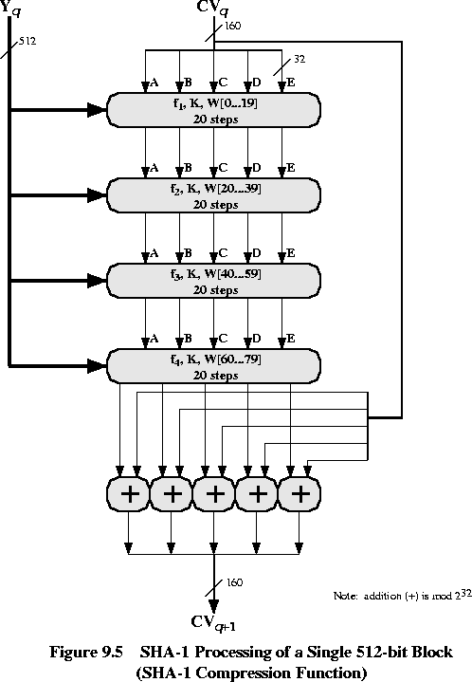
Source:http://cwx.prenhall.com/bookbind/pubbooks/stallings8/chapter0/deluxe.html

Slide 24
  However, SHA-1 is deprecated in 2011 by NIST due to fundamental security weaknesses demonstrated in various analyses and theoretical attacks
  The first practical collision attack with complexity of 2^{57.5} on SHA-1 is presented in 2015
    A collision can be found in 10 days on a 64-GeForce GTX970 GPU cluster
  The first public collision on SHA-1 is demonstrated in 2017
Notes:
References:
- M. Stevens, P. Karpman, and T. Peyrin, Freestart collision for full SHA-1, EUROCRYPT 2016
- Stevens, Marc; Bursztein, Elie; Karpman, Pierre; Albertini, Ange; Markov, Yarik. "The first collision for full SHA-1". Shattered IO. Retrieved 23 February 2017.

Slide 25
 | MD5 | SHA-1 | RIPEMD-160 | SHA-2 | SHA-3
Digest length (in bits) | 128 | 160 | 160 | 224 / 256 / 384 / 512 | 224 / 256 / 384 / 512 / arbitrary
Basic unit of processing (in bits) | 512 | 512 | 512 | 512 / 1024 | 1152 / 1088 / 832 / 576 / 1344 / 1088
Number of steps | 64 (4 round of 16) | 80 (4 rounds of 20) | 160 (5 paired rounds of 16) | 64 / 80 | 24
Maximum message size | ∞ | 2⁶⁴-1 | ∞ | 2⁶⁴-1 / 2¹²⁸-1 | ∞
Remark | Considered broken, should not be used | Deprecated, should not be used | Mainly used in PGP | Widely used | A new hashing standard in 2015
Notes:
Cryptography and Network Security (3rd Edition), A.Kahate, McGraw Hill
Wikipedia, https://en.wikipedia.org/wiki/Template:Comparison_of_SHA_functions

Slide 26
Digital Certificate
A digital certificate is an electronic file that confirms the identity of the server (the certificate holder)
It provides a way of authentication. That is, to prove who they claim to be
  For example, when we visit a bank’s web site, we can check the digital certificate provided by the server to see if it is a legitimate web site or a forged web site
It also contains the certificate holder’s public key, which can be used by the client
  to encrypt the data before sending to the server
  to verify the signature signed by the server
Notes:
Demo

Slide 27
Certification Authority (CA)
Digital certificates are issued by Certification Authorities (CA)
  Examples: Comodo, Symantec Group, Go Daddy Group, GlobalSign, VeriSign
Acts as a trusted third party to verify the identity of digital certificate subscribers

Slide 28
X.509 Authentication Service
X.509 is a standard defining the format of public-key certificate associated with each user.
The X.509 certificate format is used in S/MIME, IP Security, SSL/TLS, and SET.
These user certificates are assumed to be created by some trusted Certification Authority (CA) and placed in the directory by the CA or by the user.

Slide 29
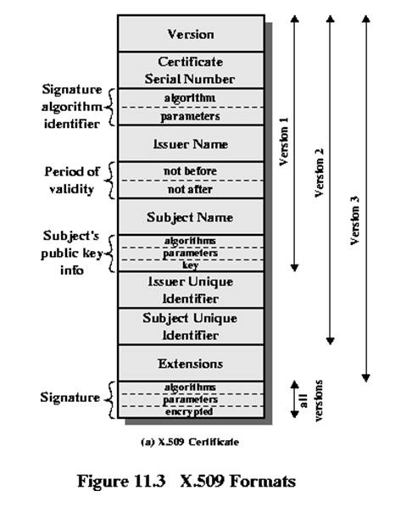
Source:http://cwx.prenhall.com/bookbind/pubbooks/stallings8/chapter0/deluxe.html

Slide 30
Characteristics of certificates generated by a CA
  Any user with access to the public key of the CA can recover the public keys of the users that were certified.
  No party other than the CA can modify the certificate without being detected.
All users subscribe to the same CA have the common trust to that CA.
All user certificates can be placed in the directory for access by all users.
For a large community, it may be more practical for more than one CA.
  Each CA provides its public key to some fraction of the user.

Slide 31
Problem
  Suppose A obtains a certificate from CA X₁
  B obtains a certificate from CA X₂.
  If A does not know the public key of X₂, then B’s certificate is useless to A.
Solution
  If the two CAs have securely exchanged their public keys, A can obtain B’s public key.
    A obtains X₂’s certificate signed by X₁
    Then A can obtain X₂’s public key.
    Hence A can obtain the certificate of
    B signed by X₂.

Slide 32
    The chain is X₁<<X₂>>X₂<<B>>
    Where Y<<X>> = the certificate of user X issued by CA Y.
    Similarly, B can obtain A’s public key
    X₂<<X₁>>X₁<<A>>
  In general, a chain with N elements can be expressed as
  X₁<<X₂>>X₂<<X₃>>…..X_{N}<<B>>
  All these certificates of CAs by CAs need to appear in the directory, and the user needs to know how they are linked to follow a path.
  X.509 suggests that CAs be arranged in a hierarchy so that navigation is straight forward.

Slide 33
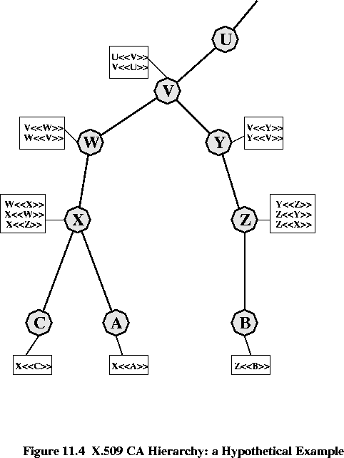
Source:http://cwx.prenhall.com/bookbind/pubbooks/stallings8/chapter0/deluxe.html
Notes:
Suppose A obtains a certificate from B and does not know whether the certificate can be trusted:
Certification path from A to B: X<<W>>W<<V>>V<<Y>>Y<<Z>>Z<<B>> (assume X doesn't have X<<Z>>)
Suppose B obtains a certificate from A and does not know whether the certificate can be trusted:
Certification path from B to A: Z<<Y>>Y<<V>>V<<W>>W<<X>>X<<A>> (assume Z doesn't have Z<<X>>)

Slide 34
The directory of each CA X includes two types of certificates.
  Forward certificates
    Certificates of X generated by other CAs.
  Reverse certificates
    Certificates of other CAs generated by X.
  Certification path from A to B
    X<<W>>W<<V>>V<<Y>>Y<<Z>>Z<<B>>
    (assume X doesn't have X<<Z>>)
  Certification path from B to A
    Z<<Y>>Y<<V>>V<<W>>W<<X>>X<<A>>
    (assume Z doesn't have Z<<X>>)
Notes:
Consider the directory of CA X:
Forward Certificate: W<<X>>
Reverse Certificate: X<<W>>

Slide 35
Revocation of certificate
  Certificate may be revoked because
    The user’s private key is assumed to be compromised.
    The user is no longer certified by this CA.
    The CA’s certificate is assumed to be compromised.
  Each CA must maintain a list consisting of all revoked but not expired certificates issued by that CA.
  User could check the directory each time a certificate is received.
  User may maintain a local cache of certificates and lists of revoked certificates.

Slide 36
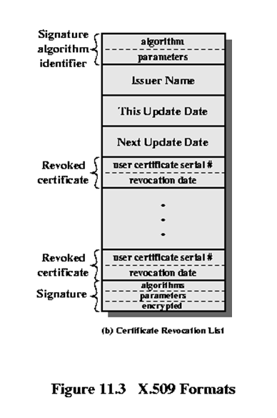
Source:http://cwx.prenhall.com/bookbind/pubbooks/stallings8/chapter0/deluxe.html

Slide 37

X.509 One-way Authentication
A
B
Notes:
A proves to B that he/she is really A:
E_{priA}{…}: A uses the private key to encrypt "…"
t_{A}: timestamp
r_{A}: random number chosen by A
sgn Data: for authentication and integrity of the message
E_{pubB}{K_{S}}: use B's public key to encrypt the session key

Slide 38

X.509 Two-way Authentication
A
B
Notes:
A proves to B that he/she is really A. After that, B proves to A that he/she is really B.
r_{A} (from B): let A know that this message corresponds to the previous message
E_{pubA}{K_{S}}: use A's public key to encrypt the session key

Slide 39

X.509 Three-way Authentication
A
B
Notes:
Sometimes it is difficult for A and B to have a synchronized clock, three-way authentication is designed to be used without the timestamp (usually setting t_A and t_B to zero). However, it will then be vulnerable to the replay attack.

Slide 40
Secure Socket Layer (SSL)
SSL was originated by Netscape.
Version 3 of the protocol was designed with public review and input from industry.
It is designed to make use of TCP to provide a reliable end-to-end secure service.
  HTTP can operate on SSL.
It consists of two layers of protocols.
SSL-specific protocols
  Handshake protocol.
  Change Cipher Spec Protocol
  Alert Protocol.
The SSL Record Protocol provides basic security services to various higher layer protocols.
Notes:
SSL is different from SSH.
In 2014, SSL 3.0 is considered as broken.

Slide 41
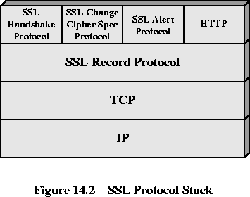
Source:http://cwx.prenhall.com/bookbind/pubbooks/stallings8/chapter0/deluxe.html

Slide 42
Two important SSL concepts
  Session
    An association between a client and a server.
    Created by the handshake protocol.
    Define a set of cryptographic security parameters, which can be shared by multiple connections.
  Connection
    A connection is a transport that provides a suitable type of service.
    Connections are transient.
    Every connection is associated with one session.

Slide 43
SSL Record Protocol
  Provides two services
    Confidentiality
      The handshake protocol defines a shared secret key that is used for conventional encryption of SSL payload
    Message Integrity
      The handshake protocol also defines a shared secret key that is used to form a Message Authentication Code (MAC).
  Take an application message to be transmitted
    Fragments the data
    Compresses the data (optional)
    Applies a MAC
    Encrypts
    Add header
    Transmit it in TCP

Slide 44
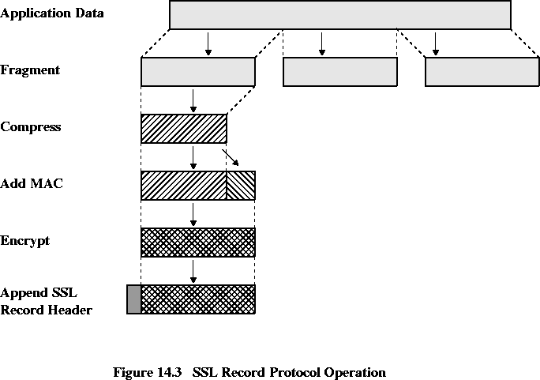
Source:http://cwx.prenhall.com/bookbind/pubbooks/stallings8/chapter0/deluxe.html

Slide 45
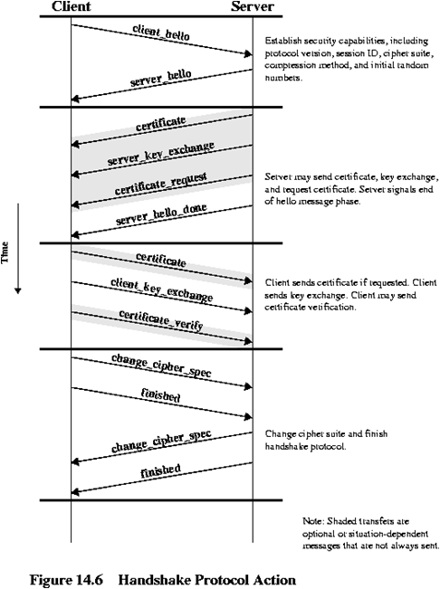
Source:http://cwx.prenhall.com/bookbind/pubbooks/stallings8/chapter0/deluxe.html
Notes:
Phase 1: Establish Security Capabilities
Phase 2: Server Authentication and Key Exchange
Phase 3: Client Authentication and Key Exchange
Phase 4: Finish

Slide 46
Handshake protocol (see diagram on the previous page)
  Allows the server and the client to authenticate each other.
  To negotiate an encryption and MAC algorithm and cryptographic keys.

Slide 47
  Phase 1: Establish Security Capabilities
    Initiate a logical connection and establish the security capabilities associates with it.
    The client initiates with a client_hello message with
      Version
        The highest SSL version understood by client
      Random (consist of a timestamp and a random number)
        Prevent replay attack.
      Session ID
        Session identifier
      cipherSuite
        List of cryptographic algorithms supported by the client.
      Compression Method
        List of compression methods supported by the client.

Slide 48
    The server replies with a server_hello message with
      Version
        The highest SSL version understood by both sides
      Random (consist of a timestamp and a random number)
        Prevent replay attack.
      Session ID
        Session identifier
      cipherSuite
        Choose the strongest cryptographic algorithm supported by both sides
        If no algorithm is supported by both sides, end the session with a handshake failure alert
      Compression Method
        Specify the compression method (if any)

Slide 49
  Phase 2: Server Authentication and Key Exchange
    Server sends certificate
      The message contains one or a chain of X.509 certificates.
      Required for any agreed-on key exchange.
    Send server_key_exchange message if required.
      When the public key in the certificate is not suitable for the key exchange.
    Send certificate_request message if necessary
      Request the client to send its own certificate
      Certificate_type
        Indicates the public-key algorithm and its use.
      Certificate authorities.
        A list of the distinguished names of acceptable certificate authorities.
    Send server_done message
Notes:
Ref: https://technet.microsoft.com/en-us/library/cc783349(v=ws.10).aspx

Slide 50
  Phase 3: Client Authentication and Key Exchange
    The client will first validate the certificate and the parameters in the server_hello message.
    Send certificate if it is requested by server.
    Send client_key_exchange message
      The content depends on the type of the key exchange.
    Send certificate_verify message if required
      A digital signature signed by the private key to verify that it is the owner the public key listed in the certificate sent earlier

Slide 51
  Phase 4: Finish
    The client sends change_cipher_spec message
      Consists of a single byte with value 1.
      At this point, the client switched to the agreed cipher suite
    Client sends finish message
      Under new algorithms, key and secrets
      Verifies that the key exchange and authentication processes were successful.
    Server send change_cipher_spec message
    Server sends its finished message.

Slide 52
Transport Layer Security (TLS)
In 2014, SSL 3.0 is considered broken.
We should use TLS (Transport Layer Secure) instead, which is based on SSL 3.0.
  The functionalities provided by SSL3.0 and TLS1.0 are almost the same
  Sometimes, TLS 1.0 is referred to as SSL 3.1
The latest version is TLS 1.2
  Defined in 2008
TLS 1.3 is still working in progress (Internet draft)
Notes:
https://tools.ietf.org/html/draft-ietf-tls-tls13-19

